Slide 1
secure data hiding in images using stenography
CAPSTONE PROJECT
Presented By:
Student Name : Rimmalapudi Bhargavi
College Name & Department : Mohan Babu University, (MCA Department)

Slide 2
OUTLINE
Problem Statement
Technology used
Wow factor
End users
Result
Conclusion
Git-hub Link
Future scope

Slide 3
Problem Statement
With increasing cyber threats, there is a need for a secure way to hide and share sensitive information. Traditional encryption methods can attract attention, making the data a target for hackers. Steganography provides a solution by hiding secret data inside images, making it invisible to the human eye. This project aims to develop a system that securely hides data inside images.
The key goals are:
Keeping data hidden without changing the image noticeably.
Ensuring security by encrypting the data before hiding it.
Making the system robust against compression or distortions.
Providing an easy-to-use tool for embedding and extracting hidden messages.
The final system will be a user-friendly application that allows secure message hiding and retrieval with password protection. This solution can be used for private communication, cybersecurity, and digital forensics to keep information safe from unauthorized access.

Slide 4
Technology used
Technologies and Libraries Used:
Programming Language: Python
Libraries Used:
OpenCV (cv2): Used for reading, modifying, and saving images.
OS Module: Used to open the encrypted image automatically.
String Module: Used for character encoding (though not explicitly used in the code).
Platform Used:
Operating System: Windows (since os.system("start encryptedImage.jpg") is used, which works on Windows).
Development Environment: Python IDLE .
Concepts Used:
Image Processing: Modifying pixel values to store hidden data.
Basic Encryption/Decryption: Mapping characters to pixel values for hiding and retrieving data.
User Authentication: Passcode verification for decryption.

Slide 5
Wow factors
Unique Features of This Project :
Secure Steganography with Passcode Protection: Unlike basic steganography, this project encrypts data using a passcode, ensuring that only authorized users can decrypt the hidden message.
Image-Based Data Hiding (No Extra File Required): The secret message is embedded directly into an image without the need for additional files, making it more covert and secure.
Lightweight & Fast Processing: Uses efficient pixel manipulation to embed and extract data quickly, without significant processing delays.
Resilience to Casual Detection: The image remains visually unchanged, making it hard to detect that a secret message is hidden inside.
Universal Character Support: Supports all ASCII characters (0-255), allowing for diverse message content, including special characters and symbols.
Simple & Portable Implementation: The project is easy to run on any Windows system with OpenCV installed, requiring no complex setups.
Automatic Image Opening for Quick Access: After encryption, the program automatically opens the image, making it easy to check the output.
Expandable for Advanced Security: Can be upgraded to use stronger encryption (AES, RSA) before embedding, enhancing security even further.

Slide 6
End users
End Users of the Project :
Cybersecurity Professionals & Ethical Hackers: Use it for secure communication and data protection.
Journalists & Whistleblowers: Safely transmit confidential information without attracting attention.
Government & Intelligence Agencies: Protect classified data and ensure covert communication.
IT Security Teams: Enhance security protocols and test data-hiding techniques.
Privacy-Conscious Individuals: Hide sensitive personal data, passwords, or private messages.
Researchers & Students: Explore steganography and learn about digital security.
Digital Forensics Experts: Detect or recover hidden messages in images during investigations.
Businesses & Corporations: Securely transmit confidential business information.

Slide 7
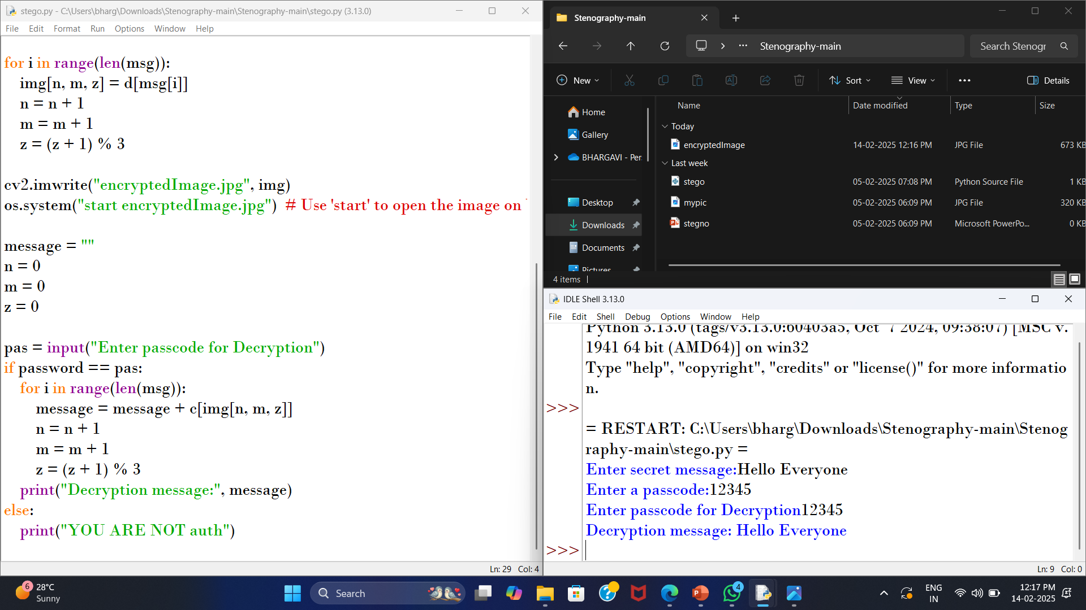
Results

Slide 8
Conclusion
In conclusion, this project successfully addresses the need for a secure method of hiding and sharing sensitive information by implementing image steganography techniques. By embedding secret messages within images. The system ensures covert data transmission without noticeable alterations to the image. The integration of encryption before embedding enhances security, making it difficult for unauthorized users to access the hidden data. Additionally, the system is designed to be robust against compression and distortions, ensuring data integrity even after image modifications. With a user-friendly interface and password protection, the project provides a practical and efficient solution for secure message hiding and retrieval. Its applications span across private communication, cybersecurity, and digital forensics, offering a reliable tool for protecting sensitive data. Looking ahead, future improvements could include stronger encryption algorithms like AES or RSA, support for larger data storage, cross-platform compatibility, and a graphical user interface (GUI) for better accessibility. Overall, this project contributes to the advancement of secure communication technologies, providing an innovative and effective approach to data protection.

Slide 9
GitHub Link
https://github.com/bhargavi7847/AICTE_Internship_Project.git

Slide 10
Future scope(optional)
Future Scope of the Project:
As cyber threats continue to evolve, the need for more secure and advanced steganography techniques is growing. This project has a strong foundation, but several enhancements can be made to improve its effectiveness, security, and usability.
Stronger Encryption Mechanisms
Advanced Steganographic Techniques
Support for Larger Data Storage
Cross-Platform Compatibility
Graphical User Interface (GUI) Development
Mobile App Integration
Robustness Against Steganalysis Attacks
Cloud-Based Steganography System
AI-Powered Steganography
Real-World Applications in Cybersecurity & Forensics
By implementing these improvements, the project can evolve into a highly secure and advanced steganography system, making it more practical, scalable, and resilient for real-world applications.

Slide 11
THANK YOU

